Slide 1


Artificial Intelligence
Dr. Sheraz Naseer
Irfan Malik

Slide 2
Artificial Intelligence
Artificial Intelligence is the branch of computer science concerned with development of methods that allow computers to learn without explicit programming.

Slide 3
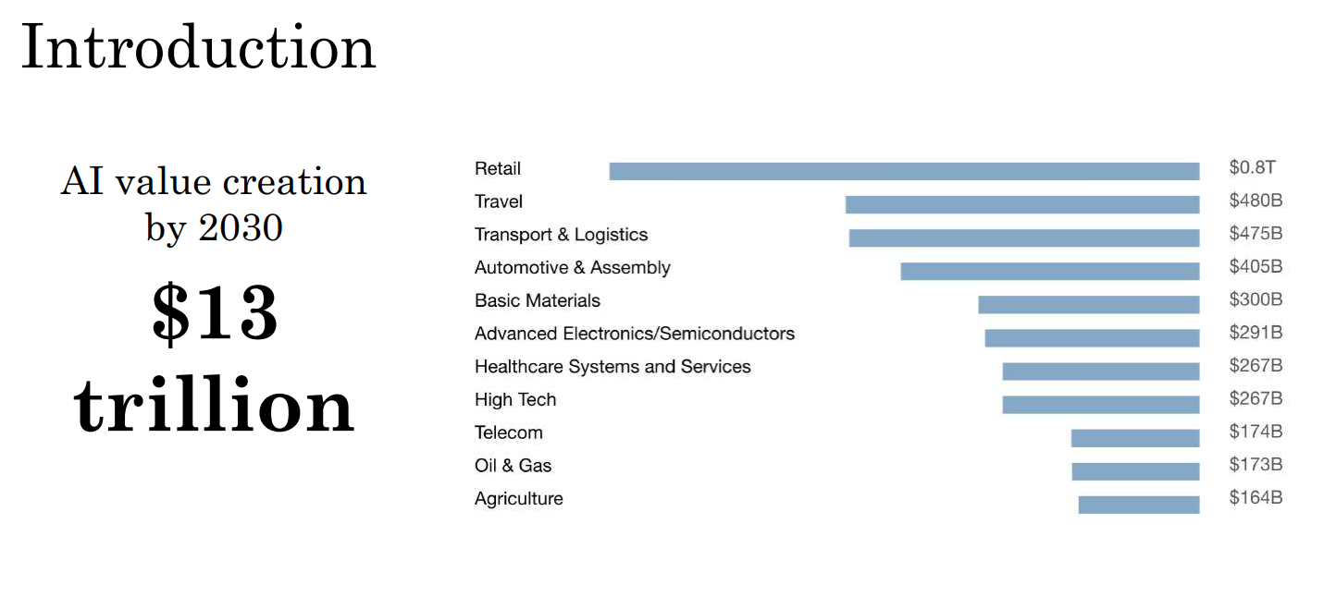
Source1: McKinsey Global Institute Source2: AI for Everyone (Deeplearning.ai)

Slide 4
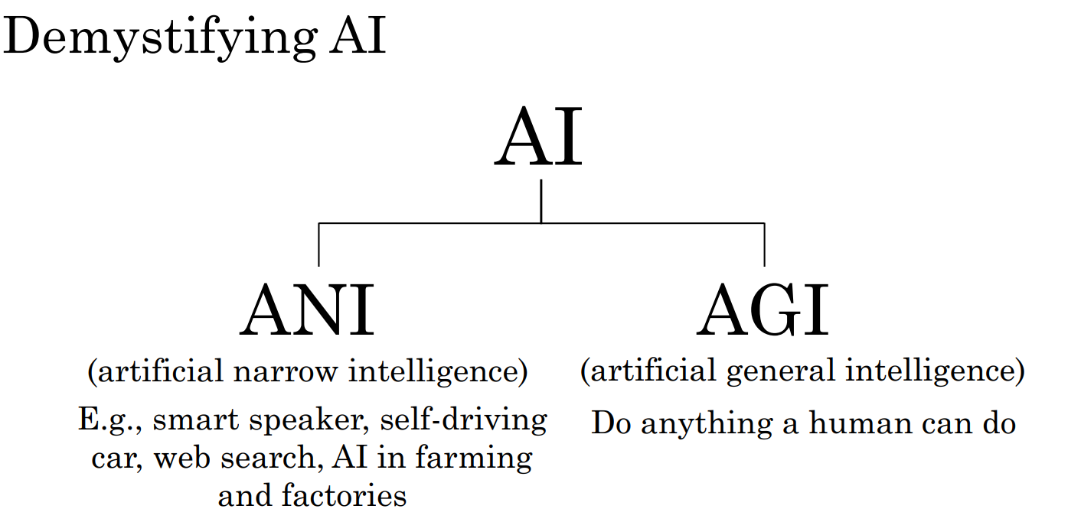
Source: Deeplearning.ai

Slide 5
Most Popular Way to Do AI:
Machine Learning
Machine Learning is a branch of AI, which focuses on methods, that can learn from examples and experience instead of relying on hard-coded rules and make predictions on new data.

Slide 6
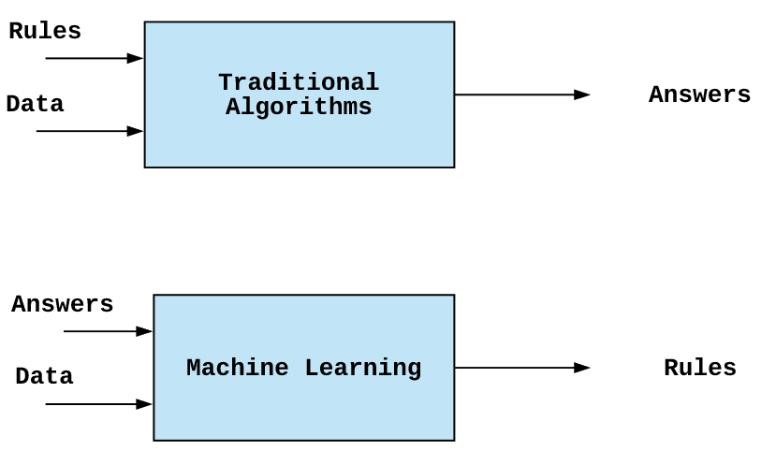
Difference in ML and Classical AI

Slide 7
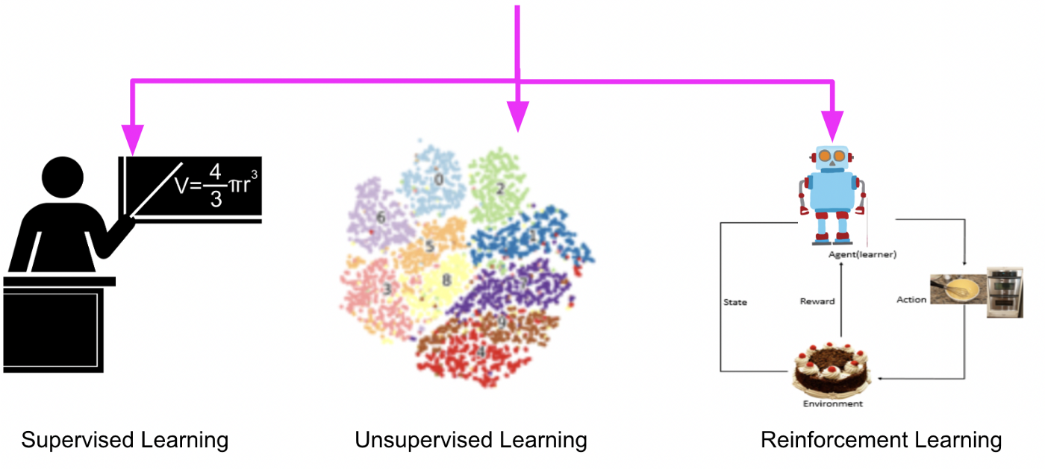
Types of Machine Learning
Supervised Learning (learning with labeled data)
Unsupervised Learning (discover patterns in unlabeled data)
Reinforcement learning (learn to act based on feedback/rewards)

Slide 8
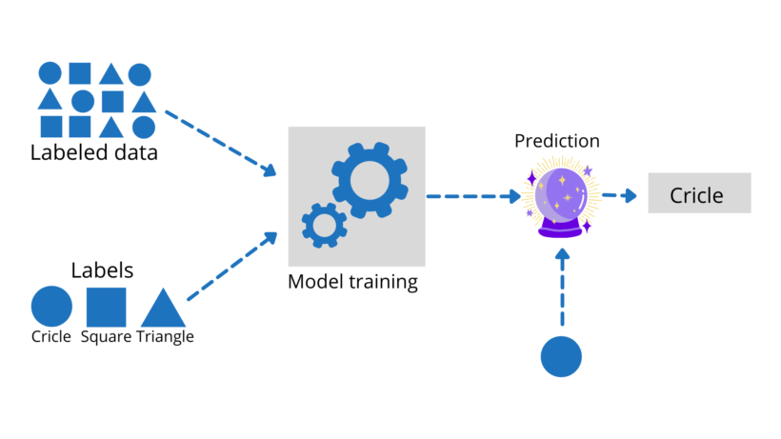
Supervised learning

Slide 9
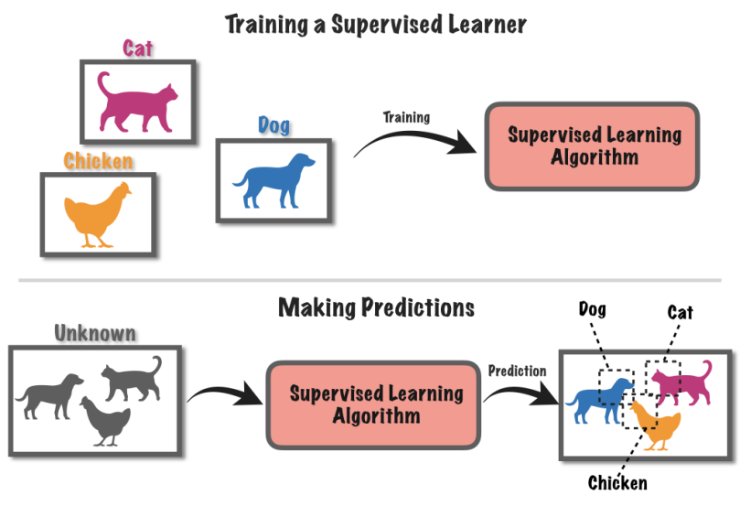

Slide 10
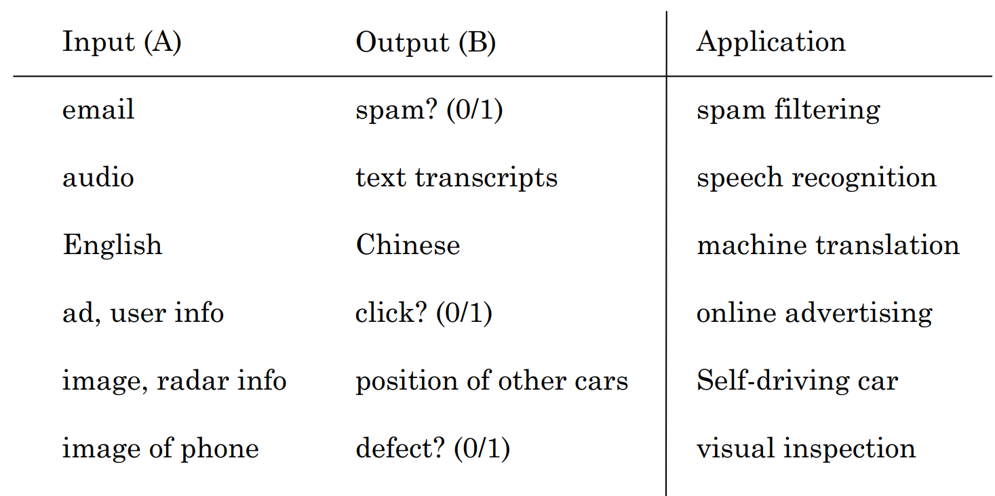
Supervised Learning Applications

Slide 11
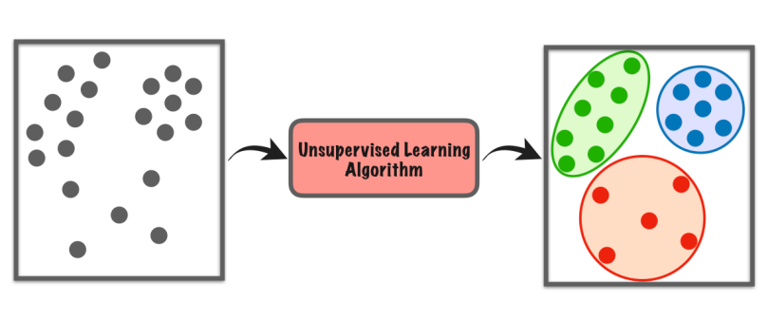
Unsupervised learning
1- Clustering
2- Dimensionality Reduction
3- Anomaly Detection

Slide 12
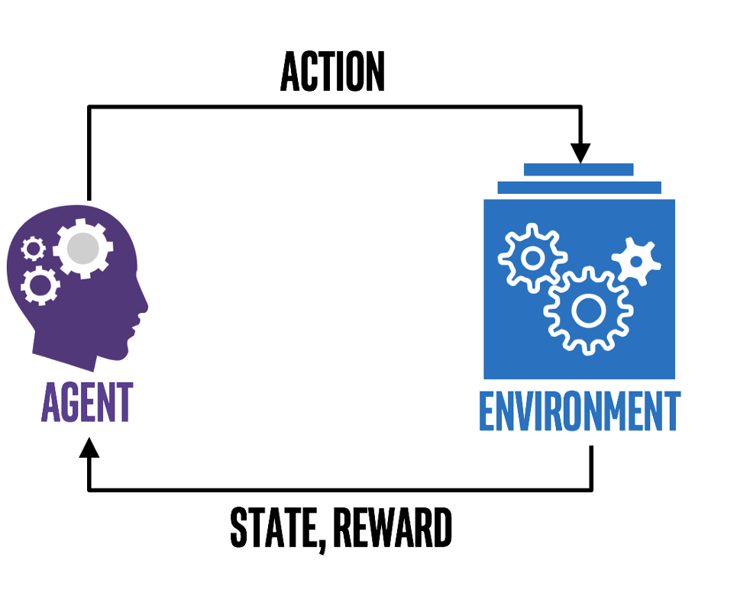
Reinforcement Learning (Carrot and Stick Learning)

Slide 13
Artificial Intelligence
Machine Learning
Deep Learning
Artificial Intelligence is the branch of computer science concerned with development of methods that allow computers to learn without explicit programming.
Machine Learning is a branch of AI, which focuses on methods, that can learn from examples and experience instead of relying on hard-coded rules and make predictions on new data.
Subfield of Machine Learning that focuses on Neural Networks (Inspired from Biological neurons) to develop learning models.

Slide 14
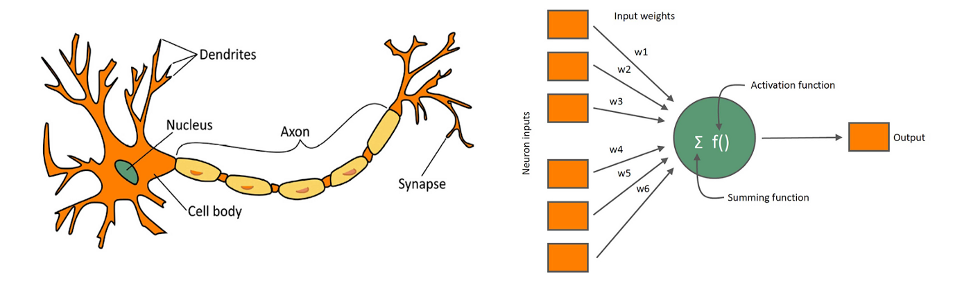
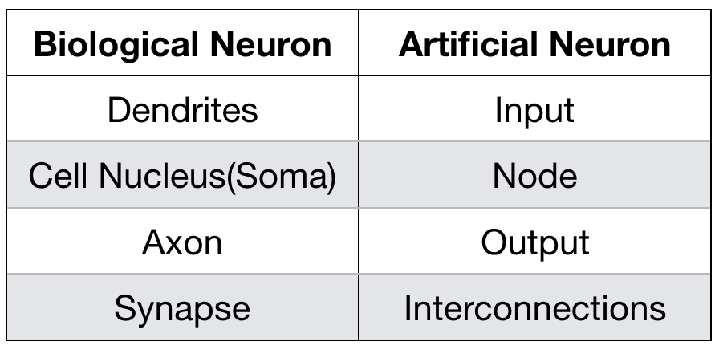
Biological Neuron
Artificial Neuron

Slide 15
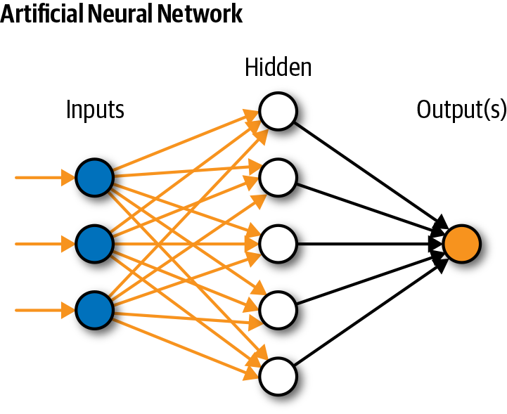
Neural Network

Slide 16
Relationship in AI, ML and DL
Machine Learning:
SVM, Tree Algorithms, Nearest neighbors, bagging, boosting, Deep Learning
Artificial Intelligence:
Search Algorithms, Rule Based Systems, Statistical Inference, Machine Learning
Deep Learning:
FCNs, CNNs, RNNs, Transformers, Autoencoders, GANs

Slide 17
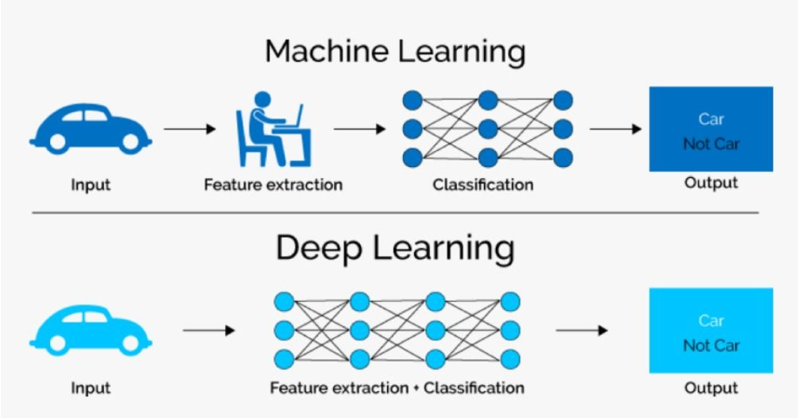
ML vs. DL

Slide 18
Generative AI
1- Text Generation (ChatGPT)
2- Image generation (Dall-E2)
3- Music Generation (Music-LM)
4- Video Generation (RunwayML Gen-2)

Slide 19
Questions ?

Slide 20
Learning with Neural Networks
(Deep Learning)

Slide 21
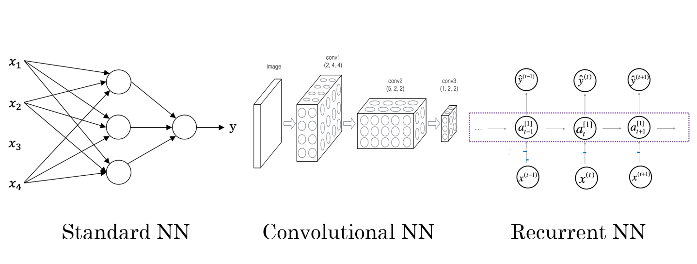
Types of Neural Networks

Slide 22
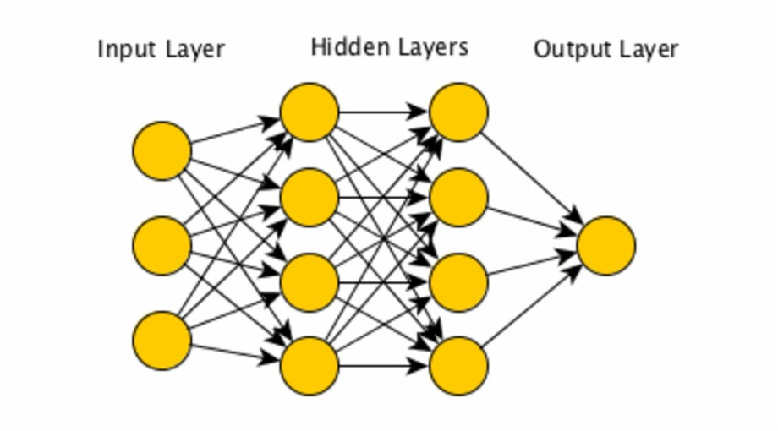
Standard Neural network

Slide 23
Standard Neural Network
Applications include:
Classification
Regression
Representation Learning
Limitations:
Computationally Expensive
Can not share parameters
Feasible for only small Datasets

